Slide 1
Home Owl
Autonomous Security Robot
Samantha Buckle
Dylan Dauz
Sameeh Olipani
Sheldon Peters

Slide 2
Problem
Homes, businesses, and facilities become vulnerable at night to break-ins or intrusions
On average, 3,062 burglaries happen in the U.S. every day
Full security systems are:
Semi-permanent
Costly
Can take time to install
Notes:
Exactly how dylan keeps about “what's the problem”

Slide 3
Project Goals
This project aims to design and build a robot for use in the monitoring of indoor spaces
Robot will be capable of:
Autonomous navigation of a building or room without the need for human control
Utilize sensors to detect loud noises or the presence of a person
Flash lights and play an alarm sound when disturbance is detected
Get signal from remote control to turn the system on and off

Slide 4
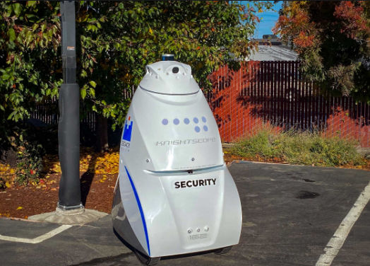
Industry Example
One example of security robot is from Knightscope Robotics, named the K5 ASR
Functions in indoor and outdoor environments
Can detect environmental anomalies or concealed weapons
Annual Cost is $60,000 to $70,000
Image from: https://www.knightscope.com/products/k5

Slide 5
Research Outline
Areas of research
Motors
What type motors we will use
Also what kind of wheels we will be using
Core Electronics
The main processor of the robot
Sensors
What sensors we will be using for navigation and detection
Navigation Algorithm
How the robot will navigate its environment
Alert System
Flashing lights and alarm sounds
Remote Signaling
On/off for the robot
On/off for the alarm

Slide 6
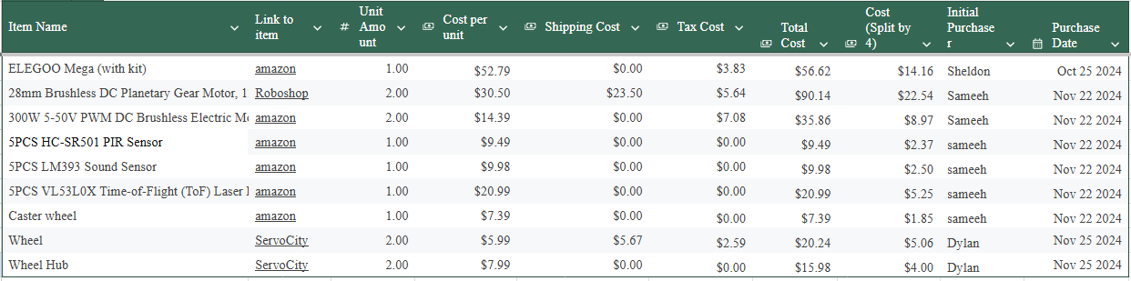
Parts List
Notes:
250

Slide 7
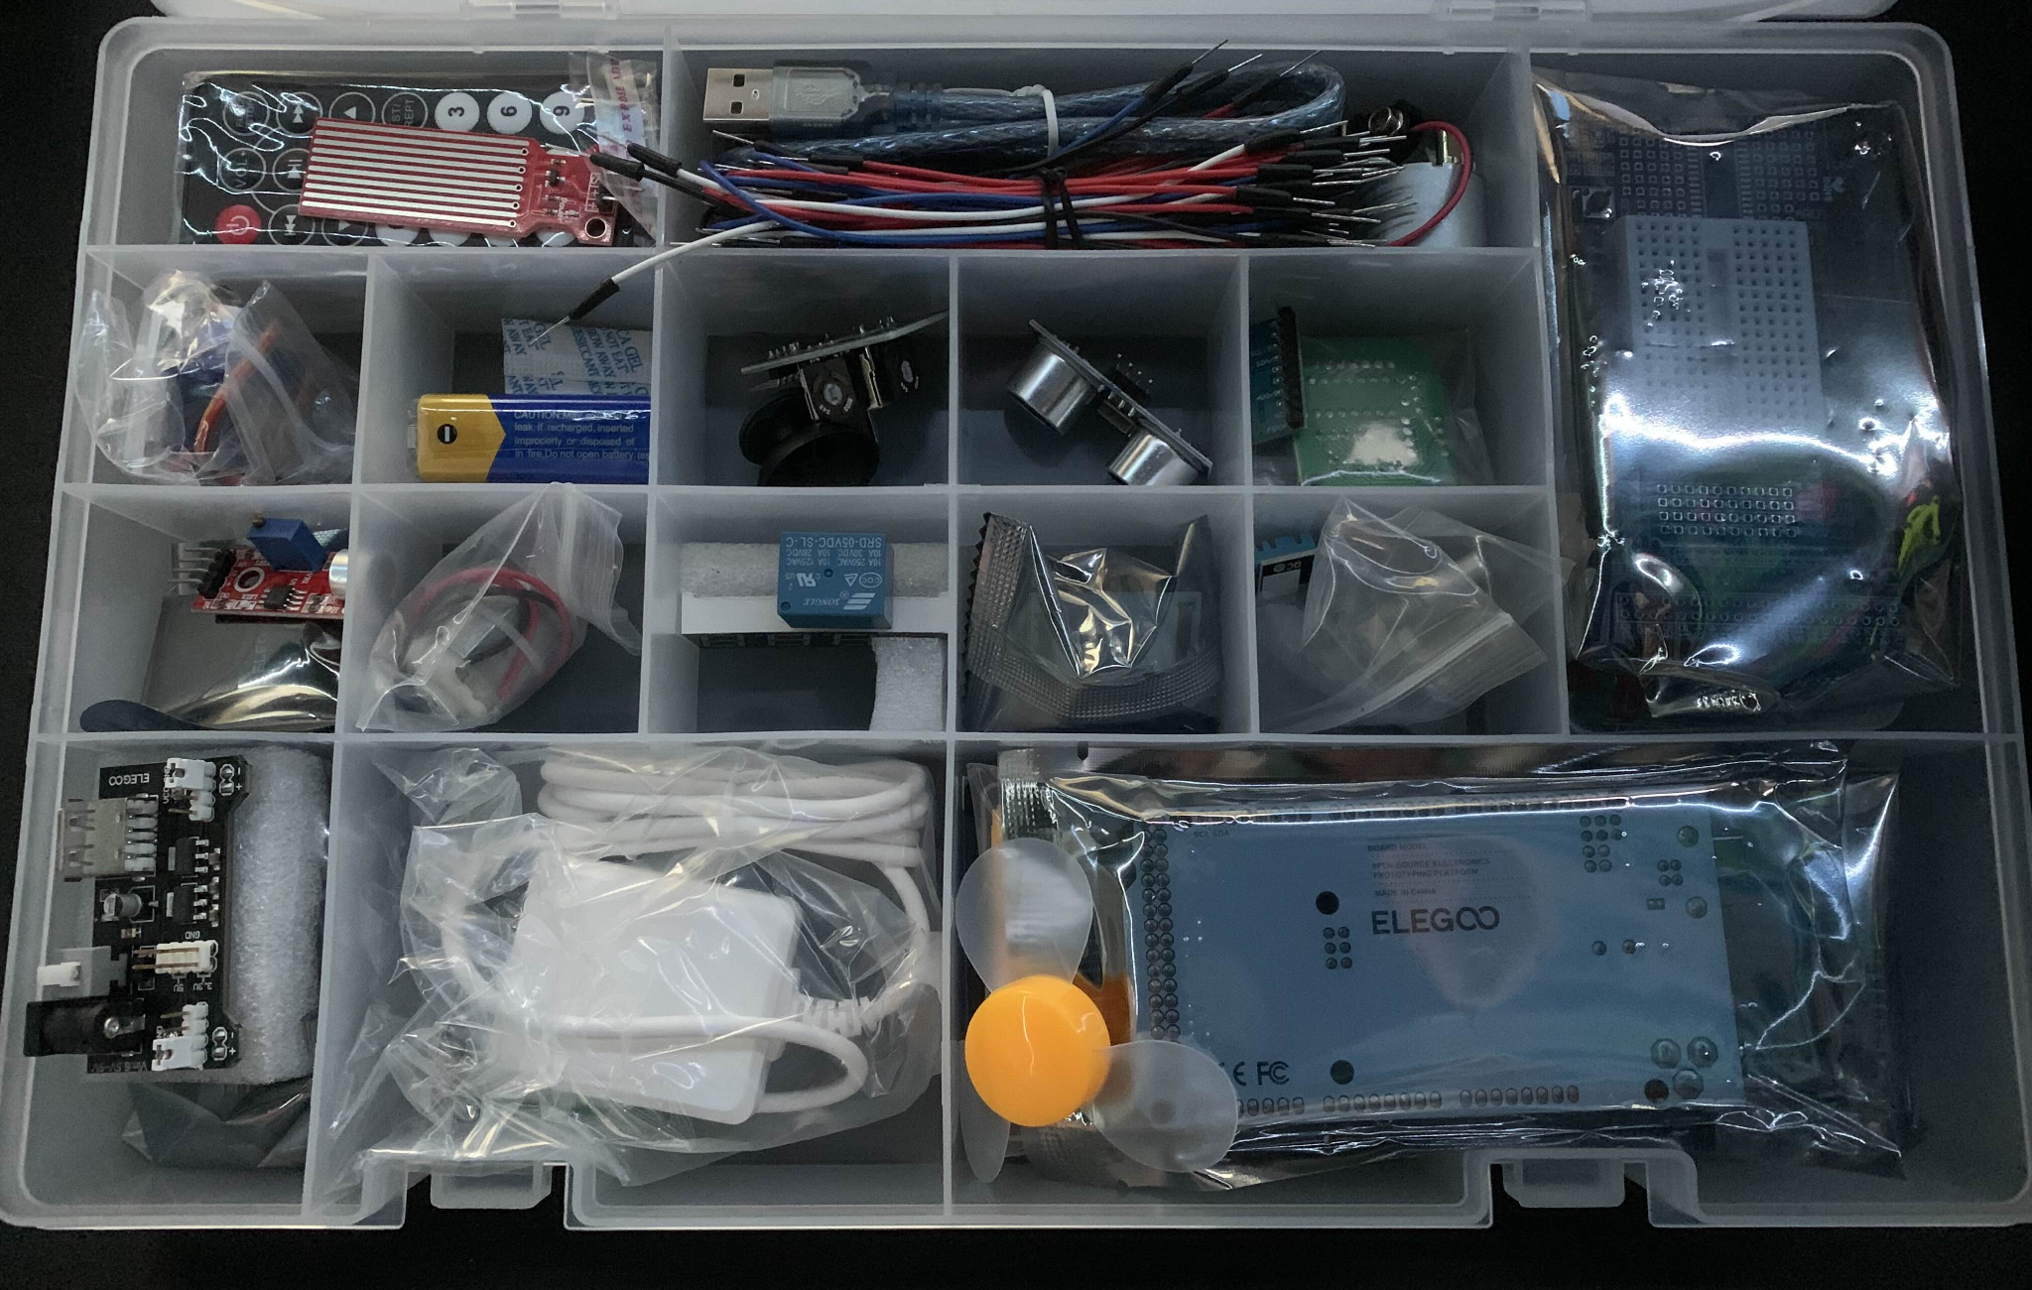
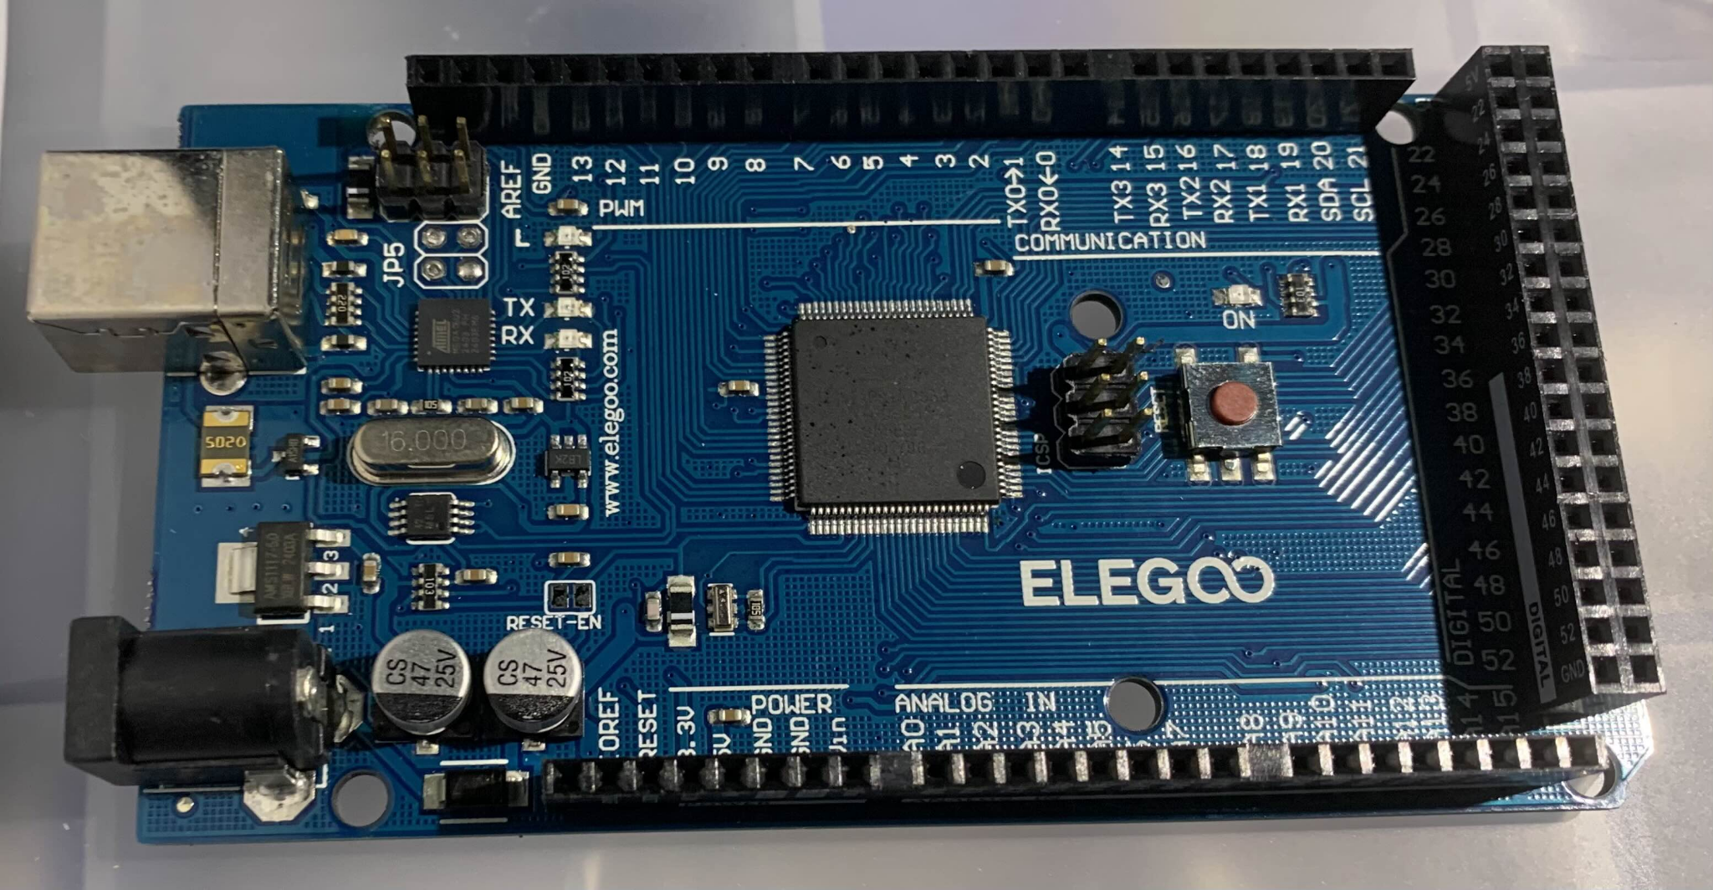
Parts

Slide 8
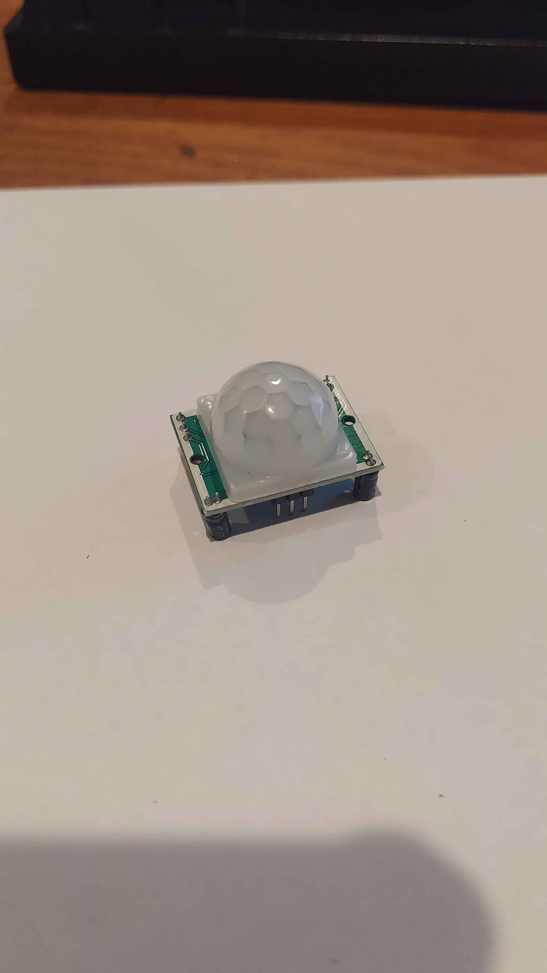
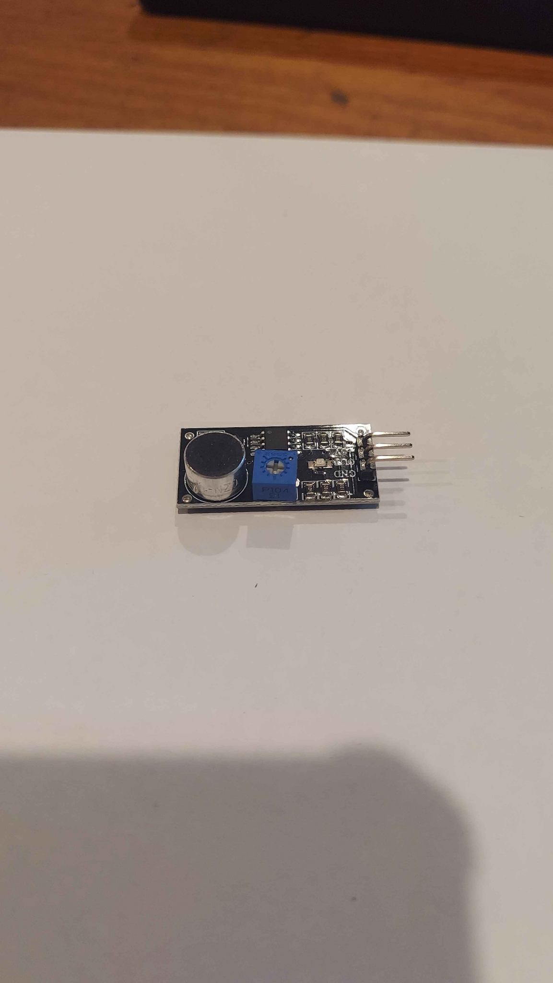
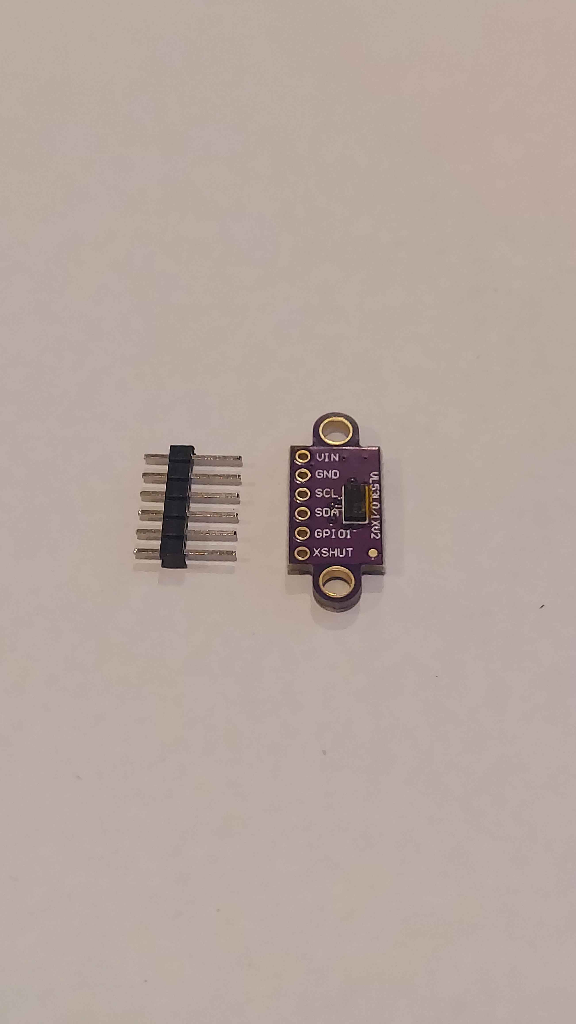
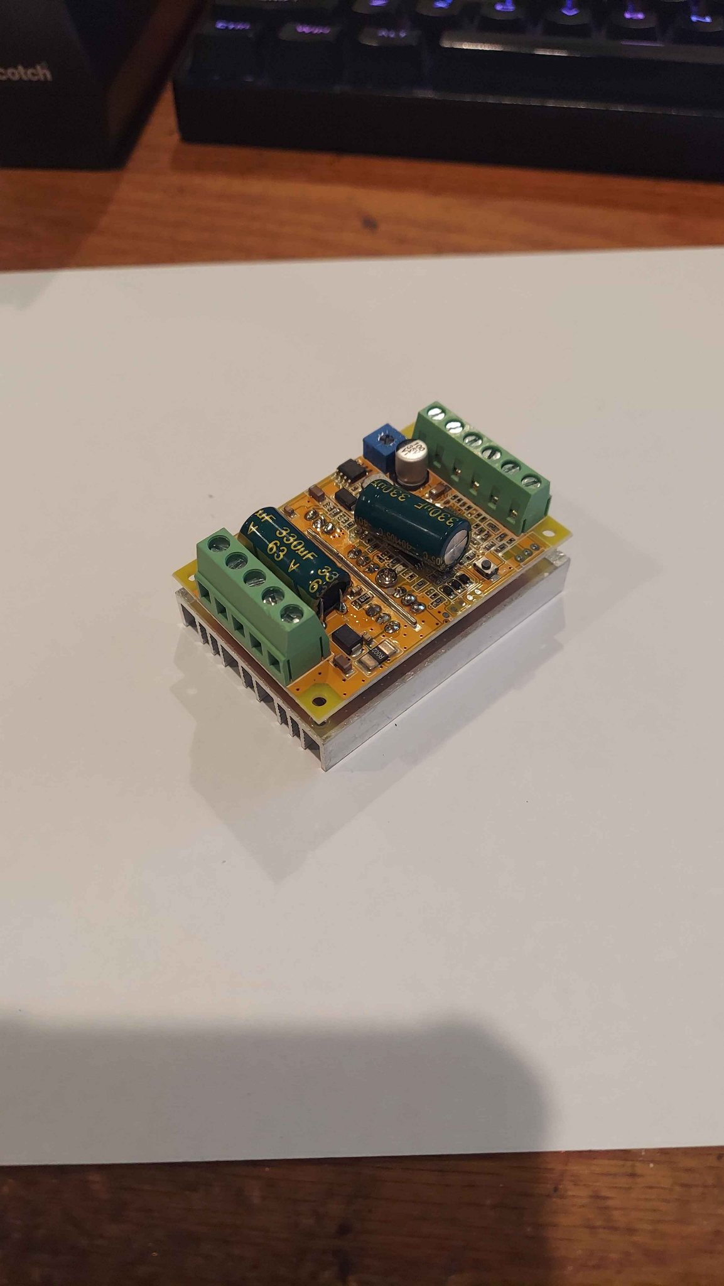
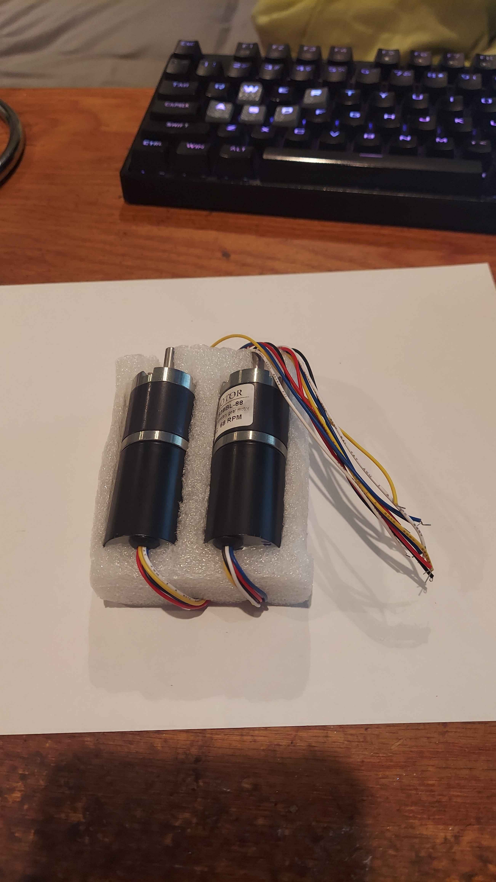
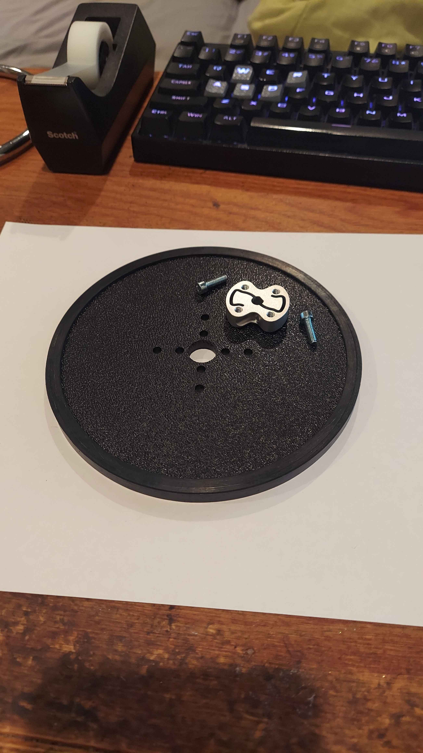
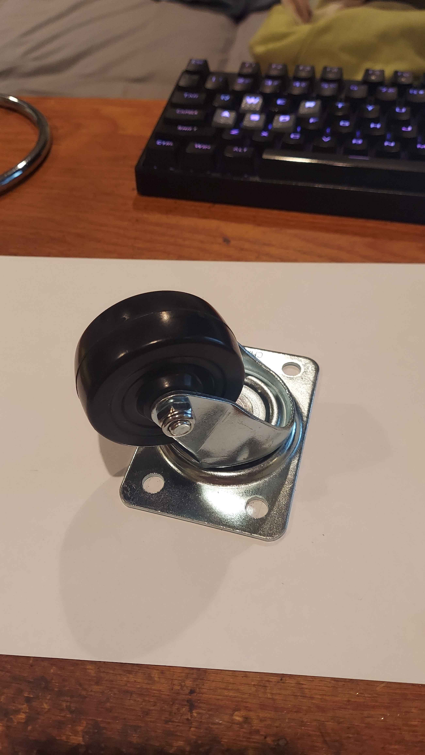
Parts

Slide 9
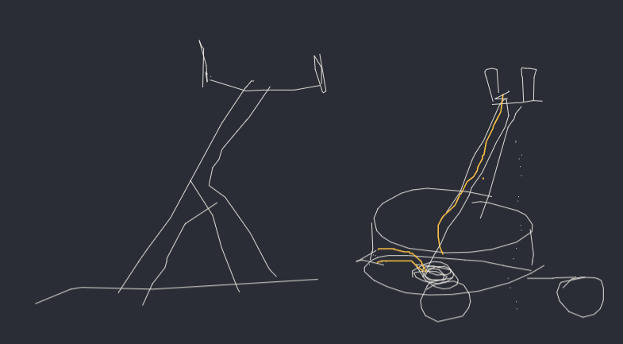
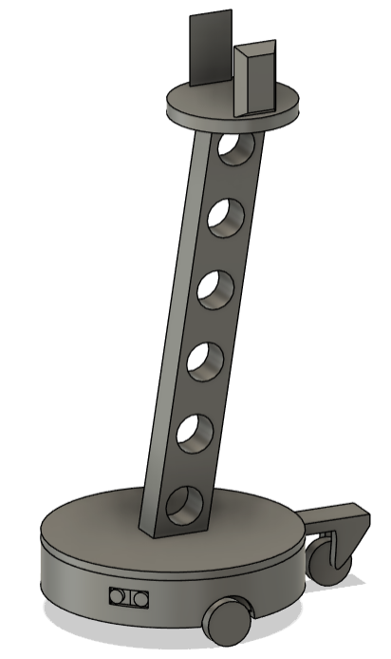
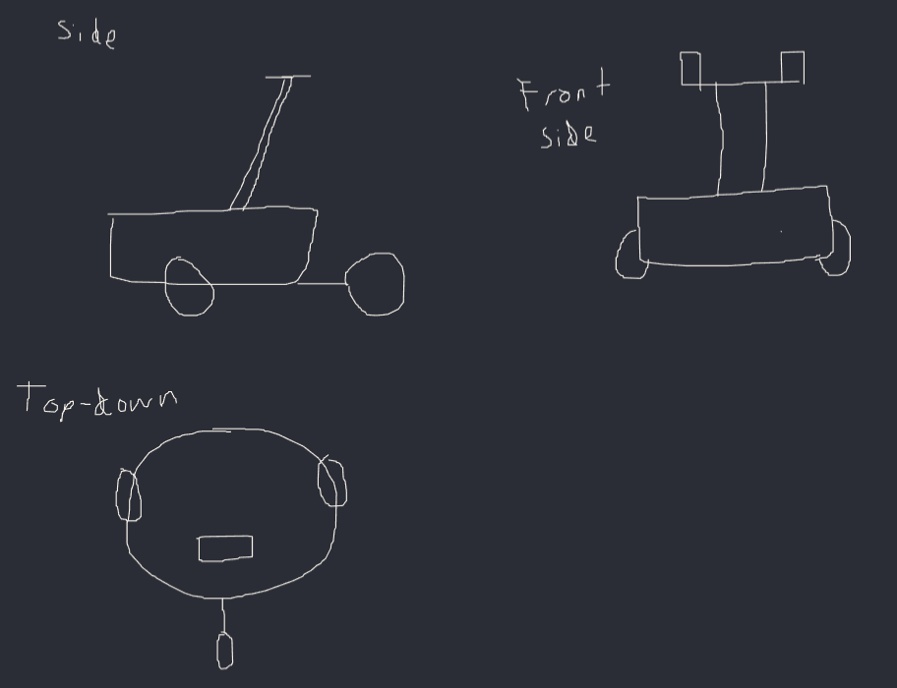
Rough Design Concepts

Slide 10
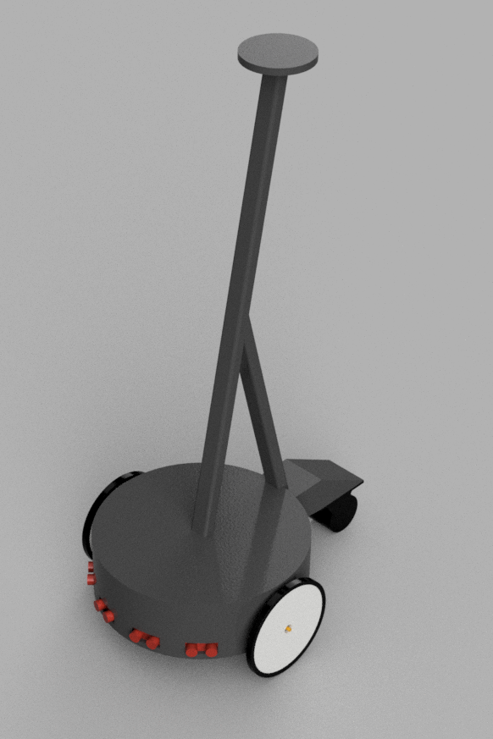
Concept Design

Slide 11

Concept Design

Slide 12
Next Steps
Finalize lab access in the spring semester
Test the sensors to ensure no faulty parts
Finalize the design and prepare it for 3D printing
Test 3D printed tolerances
Necessary for mounting parts to 3D printed bodies

